Slide 1
Failure
Something to Embrace and Celebrate or something to avoid?
An Opportunity for swimmers and divers to grow.

Slide 2
Purpose of our discussion
Remind you that you can use failure to your advantage.
“Think outside the box” on the term failure
Prepare you for a challenging season ahead

Slide 3
“You are going to fail – and likely more than once. If you don’t fail then you are probably playing it too safe.”
Tony Wagner
Creating Innovators

Slide 4
“As you reflect on the causes of your failure(s), you will come to better understand yourself – your strengths and weaknesses – and you will adjust your aspirations accordingly.”
Tony Wagner

Slide 5
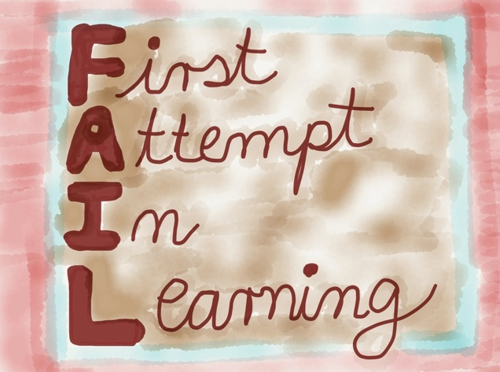
The most innovative companies celebrate failure.
“Fail early and often.”

Slide 6
What is Failure?
How do you define failure in swimming or diving?
Not reaching your goal time or score?
Failing a dive?
Missing a turn?
Not winning the race?
Breathing too much?
The answers could be numerous.

Slide 7
“It seems failure tends to be more public than success.”
Tony Wagner

Slide 8
Taking a look at “failure” outside of swimming and diving
Perhaps we could examine several examples of failure to success outside of our area of swimming and diving.

Slide 10
But, whether we like it or not, failure is a necessary stepping stone to achieving our dreams.”
Tony Wagner

Slide 11
Creating a “Failure CV”
Read article by Scott Jaschik
https://www.insidehighered.com/news/2016/05/02/professors-failure-cv-prompts-discussion-what-constitutes-academic-success#.WL6u5G1_KpE.mailto
Recall personal “failures” in swimming.
Think of the outcome of your failures. What did you do next?
Create a “Failure CV” of your own, including outcomes or lessons learned.

Slide 12
Growing from Failures
Each time we “fail” during a race is an opportunity to learn from the experience. Failure makes us better.
View “failures” as an opportunity to move forward in your training.
Remember: Failures are opportunities, not the end of the road. What you choose to do when you “fail” will determine the ultimate outcome.

